Slide 1
10 June 2020

Slide 2

APPLIED CRYPTOGRAPHY
Lecture 1

Slide 3
Modular Arithmetic
10 June 2020

Slide 4
Introduction
The division relationship (a = q × n + r) discussed in the previous section has two inputs (a and n) and two outputs (q and r).
In modular arithmetic, we are interested in only one of the outputs, the remainder r.
10 June 2020

Slide 5
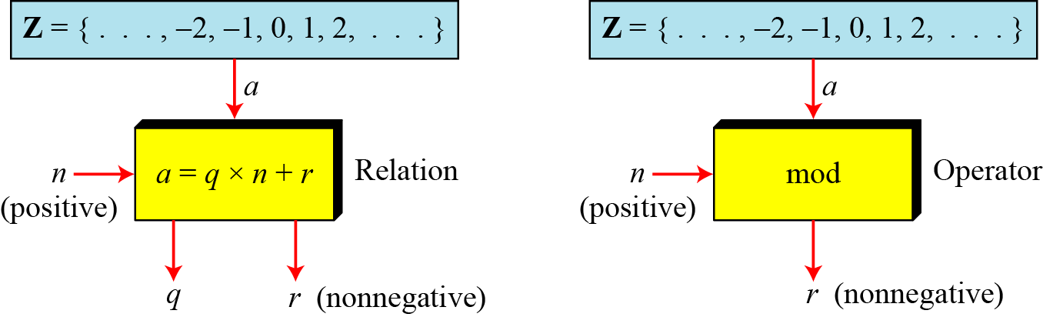
Modulo Operator
The modulo operator is shown as mod.
The second input (n) is called the modulus.
The output r is called the residue.
Division algorithm and modulo operator
10 June 2020

Slide 6
Example
a) 27 mod 5
Dividing 27 by 5 results in r = 2
b) 36 mod 12
Dividing 36 by 12 results in r = 0.
c) −18 mod 14
Dividing −18 by 14 results in r = −4. After adding the modulus r = 10
d) −7 mod 10
Dividing −7 by 10 results in r = −7. After adding the modulus to −7, r = 3.
10 June 2020

Slide 7
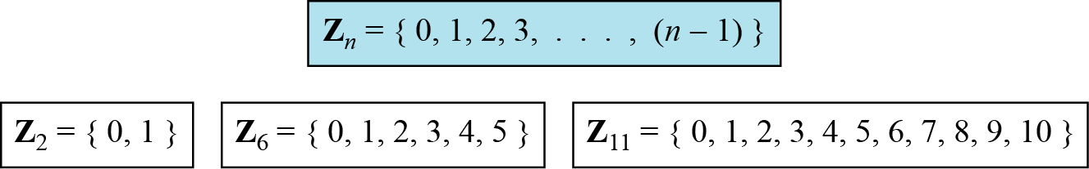
Set of residues
The modulo operation creates a set, which in modular arithmetic
is referred to as the set of least residues modulo n or Z_{n}.
Some Z_{n} sets
10 June 2020

Slide 8
Congruence
To show that two integers are congruent, we use the congruence operator ( ≡ ). For example:
10 June 2020

Slide 9
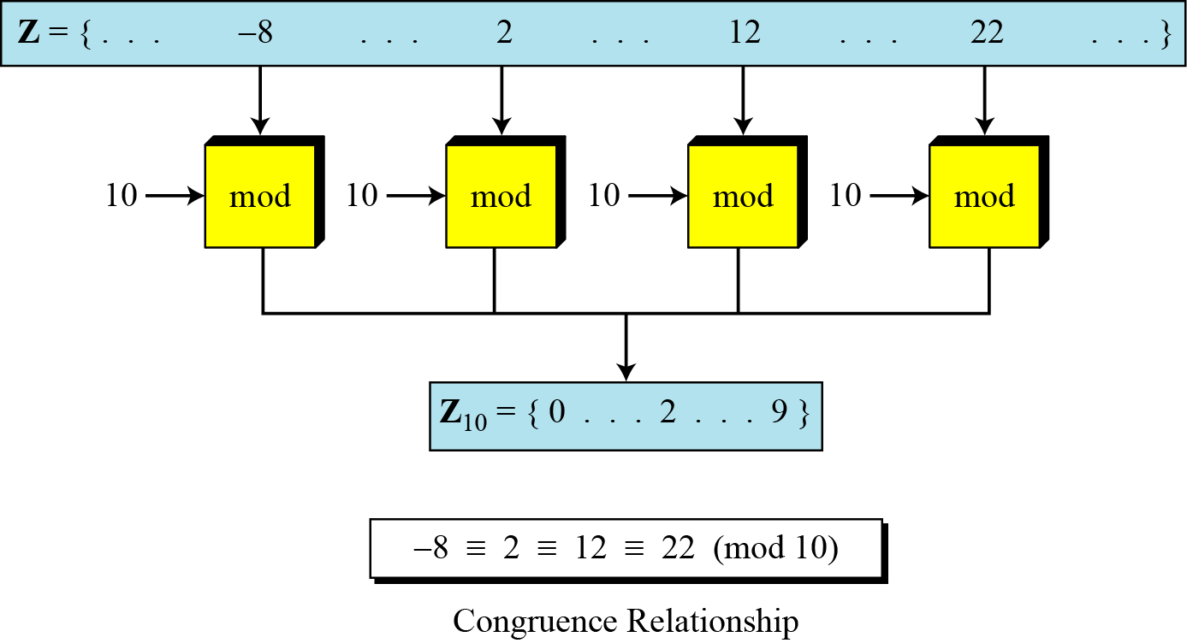
Concept of Congruence
10 June 2020

Slide 10
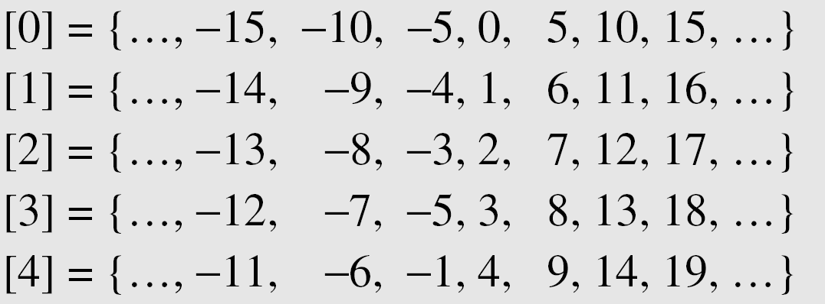
Continued..
A residue class [a] or [a]_{n} is the set of integers congruent
modulo n.
Residue Classes
8 July 2020

Slide 11
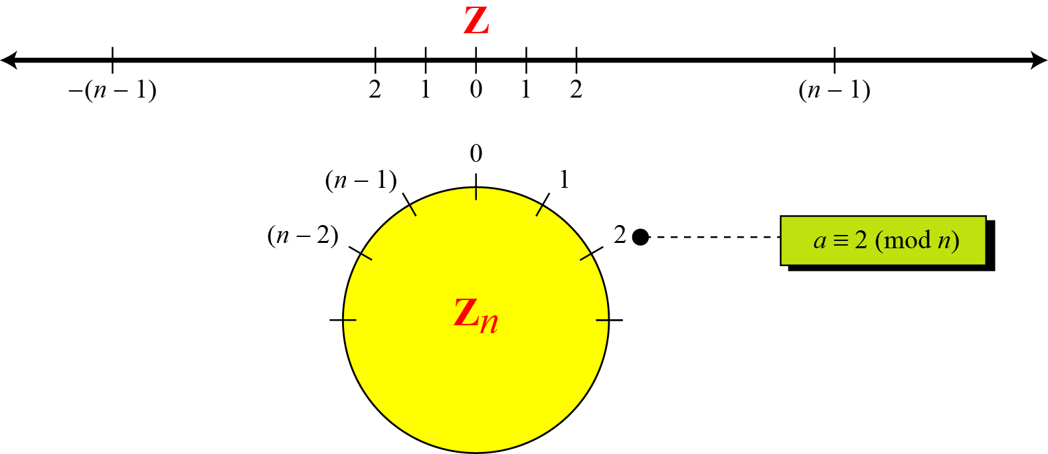
Continued..
Comparison of Z and Z_{n} using graphs

Slide 12
Continued .. Example
We use modular arithmetic in our daily life; for example, we use a
clock to measure time. Our clock system uses modulo 12 arithmetic.
However, instead of a 0 we use the number 12.

Slide 13
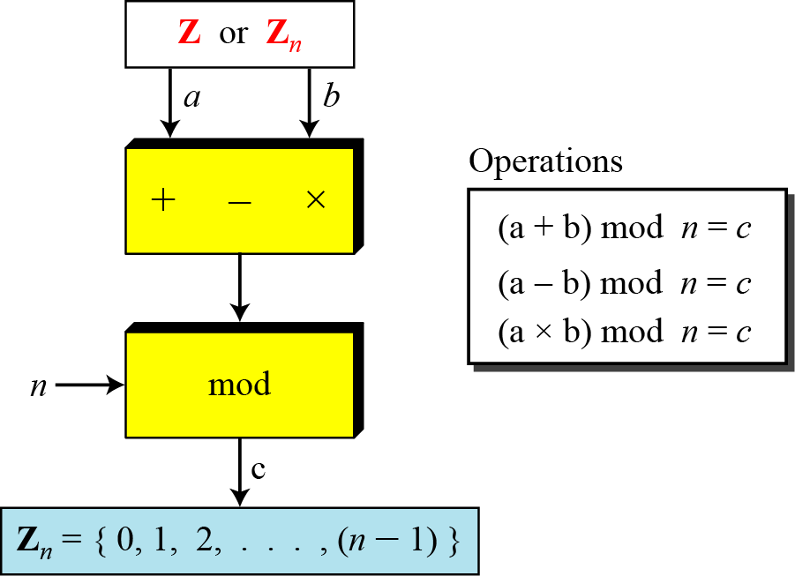
Operation on Zn
The three binary operations that we discussed for the set Z can
also be defined for the set Zn. The result may need to be mapped to
Zn using the mod operator.
Binary operations in Z_{n}

Slide 14
Example-1
Perform the following operations (the inputs come from Zn):
a) Add 7 to 14 in Z15.
b) Subtract 11 from 7 in Z13.
c) Multiply 11 by 7 in Z20.

Slide 15
Example-2
Perform the following operations (the inputs come from either Z or Z_{n}):
a) Add 17 to 27 in Z₁₄.
b) Subtract 43 from 12 in Z₁₃.
c) Multiply 123 by −10 in Z₁₉.

Slide 16
Properties of Congruence
1. (1,723,345 + 2,124,945) mod 11 = (8 + 9) mod 11 = 6
2. (1,723,345 − 2,124,945) mod 16 = (8 − 9) mod 11 = 10
3. (1,723,345 × 2,124,945) mod 16 = (8 × 9) mod 11 = 6

Slide 17
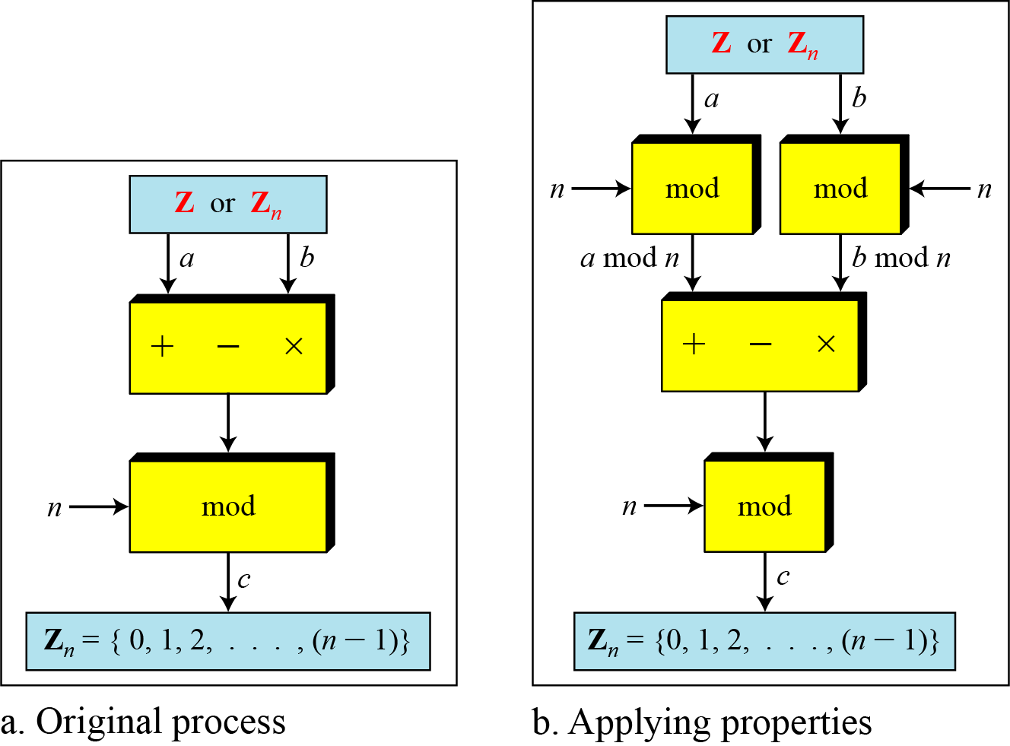
Properties of mode operator

Slide 18
Continued ..
In arithmetic, we often need to find the remainder of powers of 10 when
divided by an integer.

Slide 19
Continued ..
We have been told in arithmetic that the remainder of an integer divided
by 3 is the same as the remainder of the sum of its decimal digits. We
write an integer as the sum of its digits multiplied by the powers of 10.

Slide 20
Inverses
When we are working in modular arithmetic, we often need to find the
inverse of a number relative to an operation. We are normally looking
for an additive inverse (relative to an addition operation) or a
multiplicative inverse (relative to a multiplication operation).

Slide 21

Additive Inverse
In Z_{n}, two numbers a and b are additive inverses of each other if
In modular arithmetic, each integer has an additive inverse.
The sum of an integer and its additive inverse is congruent to 0 modulo n.
Example:
Find all additive inverse pairs in Z10.
The six pairs of additive inverses are
(0, 0), (1, 9), (2, 8), (3, 7), (4, 6), and (5, 5).

Slide 22
Multiplicative Inverse
In Z_{n}, two numbers a and b are the multiplicative inverse of each other if
In modular arithmetic, an integer may or may not have a multiplicative inverse.
When it does, the product of the integer and its multiplicative inverse is congruent to 1 modulo n.
Example:
Find all multiplicative inverse pairs in Z₁₁.
Solution:
There are seven pairs:
(1, 1), (2, 6), (3, 4), (5, 9), (7, 8), (9, 9), and (10, 10).

Slide 23
Example
1) Find the multiplicative inverse of 8 in Z₁₀.
Solution:
There is no multiplicative inverse because gcd (10, 8) = 2 ≠ 1.
In other words, we cannot find any number between 0 and 9
such that when multiplied by 8, the result is congruent to 1.
2) Find all multiplicative inverses in Z₁₀.
Solution:
There are only three pairs: (1, 1), (3, 7) and (9, 9).
The numbers 0, 2, 4, 5, 6, and 8
do not have a multiplicative inverse.

Slide 24
Continued ..
The extended Euclidean algorithm finds the multiplicative inverses
of b in Z_{n} when n and b are given and gcd (n, b) = 1.
The multiplicative inverse of b is the value of t after being
mapped to Z_{n}.

Slide 25
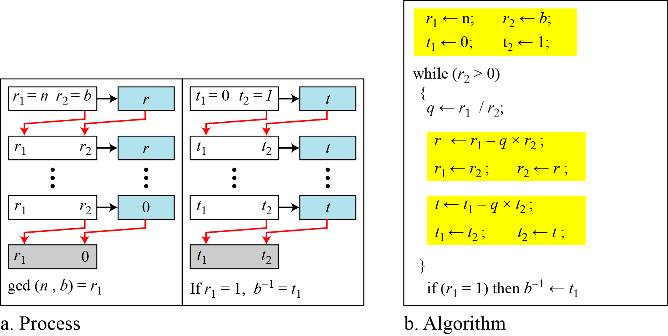
Continued .. Example
Using extended Euclidean algorithm to find multiplicative inverse

Slide 26
Example
Find the multiplicative inverse of 11 in Z₂₆
The gcd (26, 11) is 1; the inverse of 11 is -7 or 19.

Slide 27
Example
Find the multiplicative inverse of 23 in Z₁₀₀.
The gcd (100, 23) is 1; the inverse of 23 is -13 or 87.

Slide 28
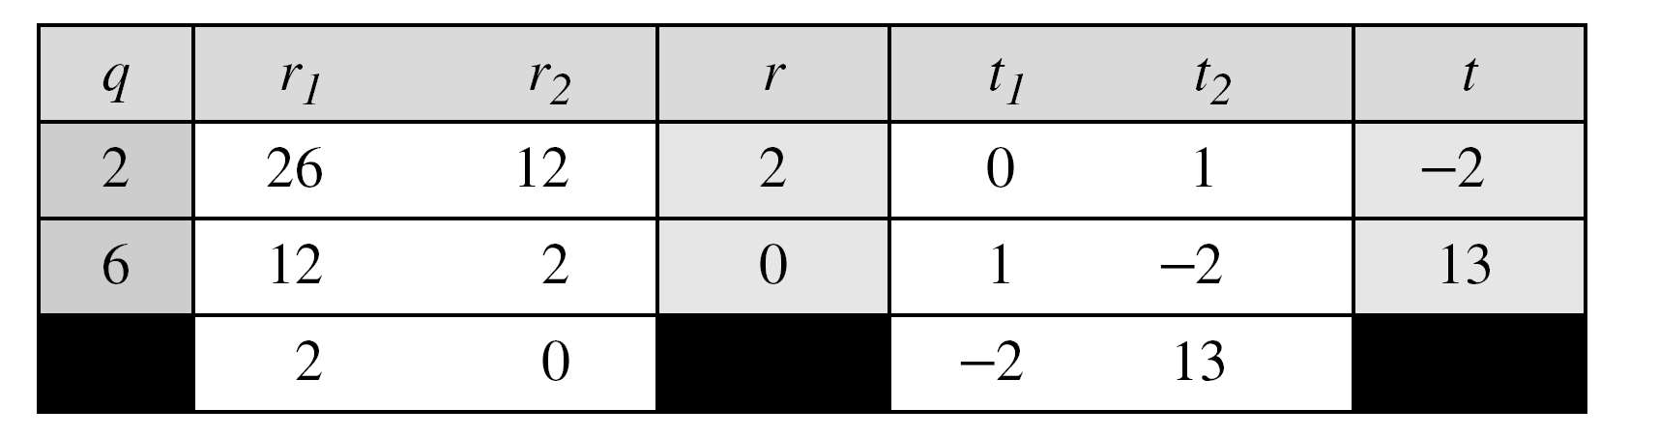
Example
Find the inverse of 12 in Z₂₆.
The gcd (26, 12) is 2; the inverse does not exist.

Slide 29
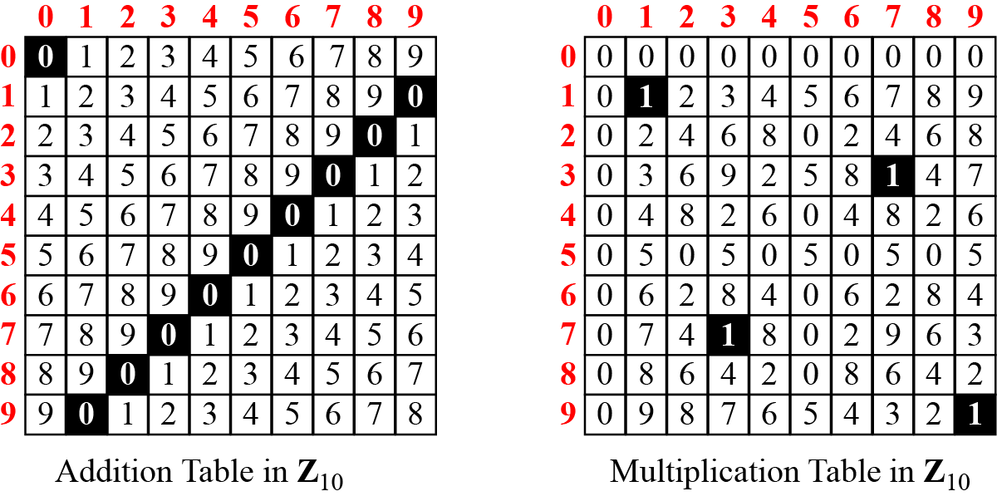
Addition and Multiplication Tables

Slide 30
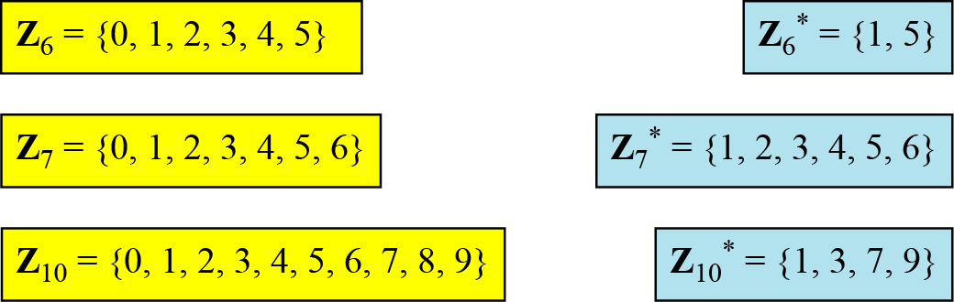
Different Sets
We need to use Zn when additive inverses are needed; we need to use
Zn* when multiplicative inverses are needed.
Some Z_{n} and Z_{n}* sets

Slide 31
Two more sets
Cryptography often uses two more sets: Z_{p} and Z_{p}*. The modulus in
these two sets is a prime number.

Slide 32
Thank You!
Next Class
Mandatory reading for the next class
https://pdfs.semanticscholar.org/40f3/95bf05420ea57578ed209c408e1f2e309094.pdf
10 June 2020

Slide 33


Vineetha B
Computer Science and Engineering
PES University, Bengaluru
10 June 2020

